Slide 1
Drone Building Inspections
Yinshuo Feng, Luying Ruan, Jim Stiegler, Hua Tong
EC 601 A2

Slide 2
Mission
Enable the Architecture, Engineering, and Construction (AEC) industry to safely and efficiently inspect structures to detect and characterize potential anomalies that require attention.

Slide 3
Where are we headed?
Inspections of the future

Slide 4
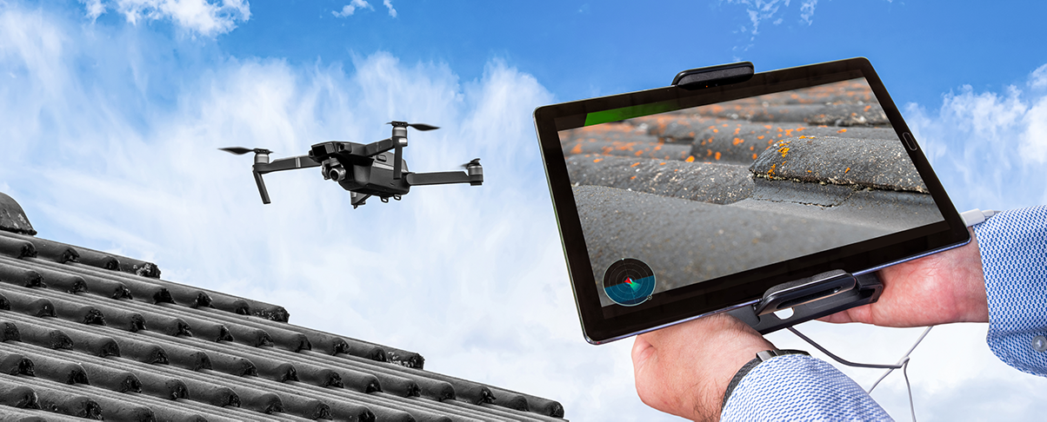
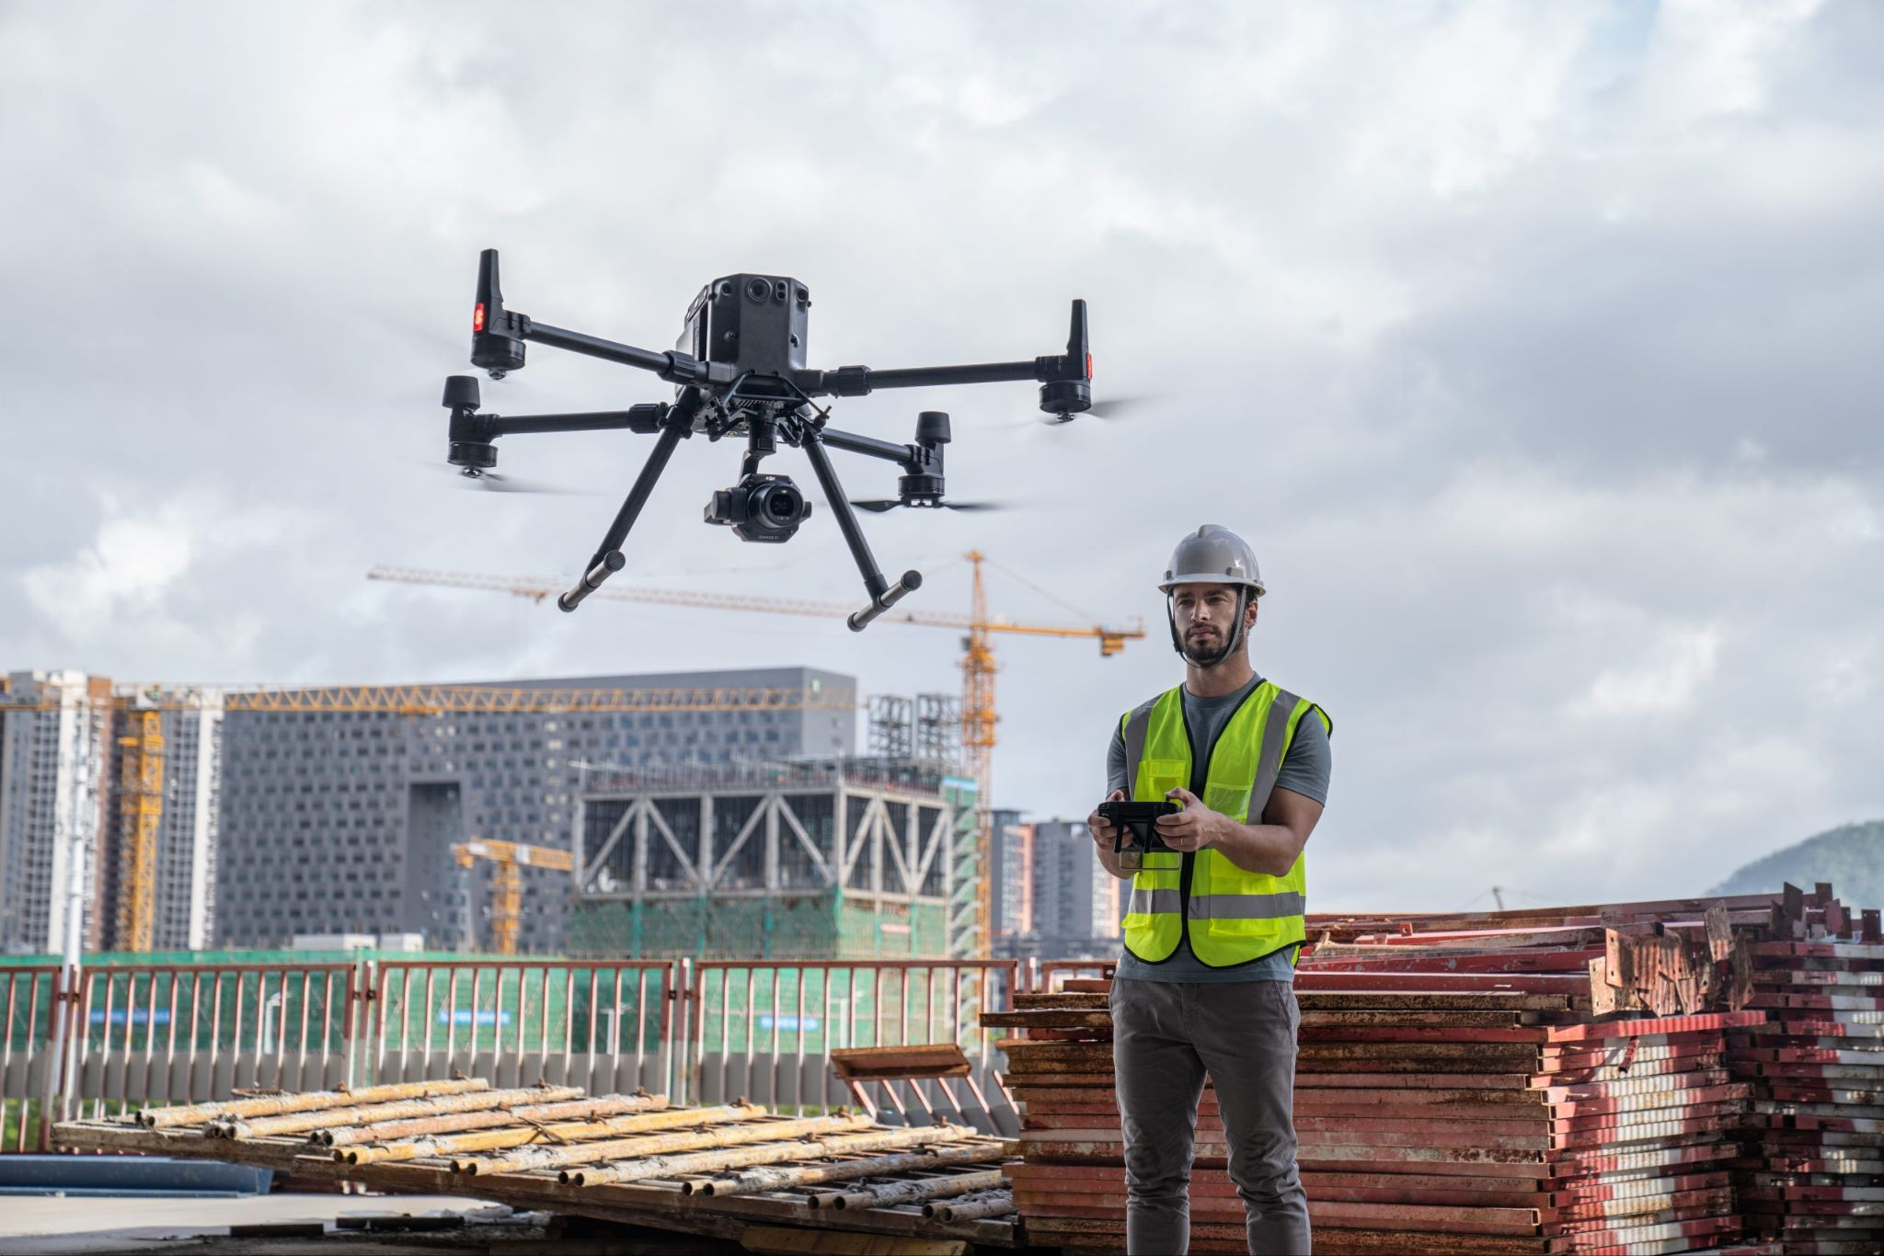
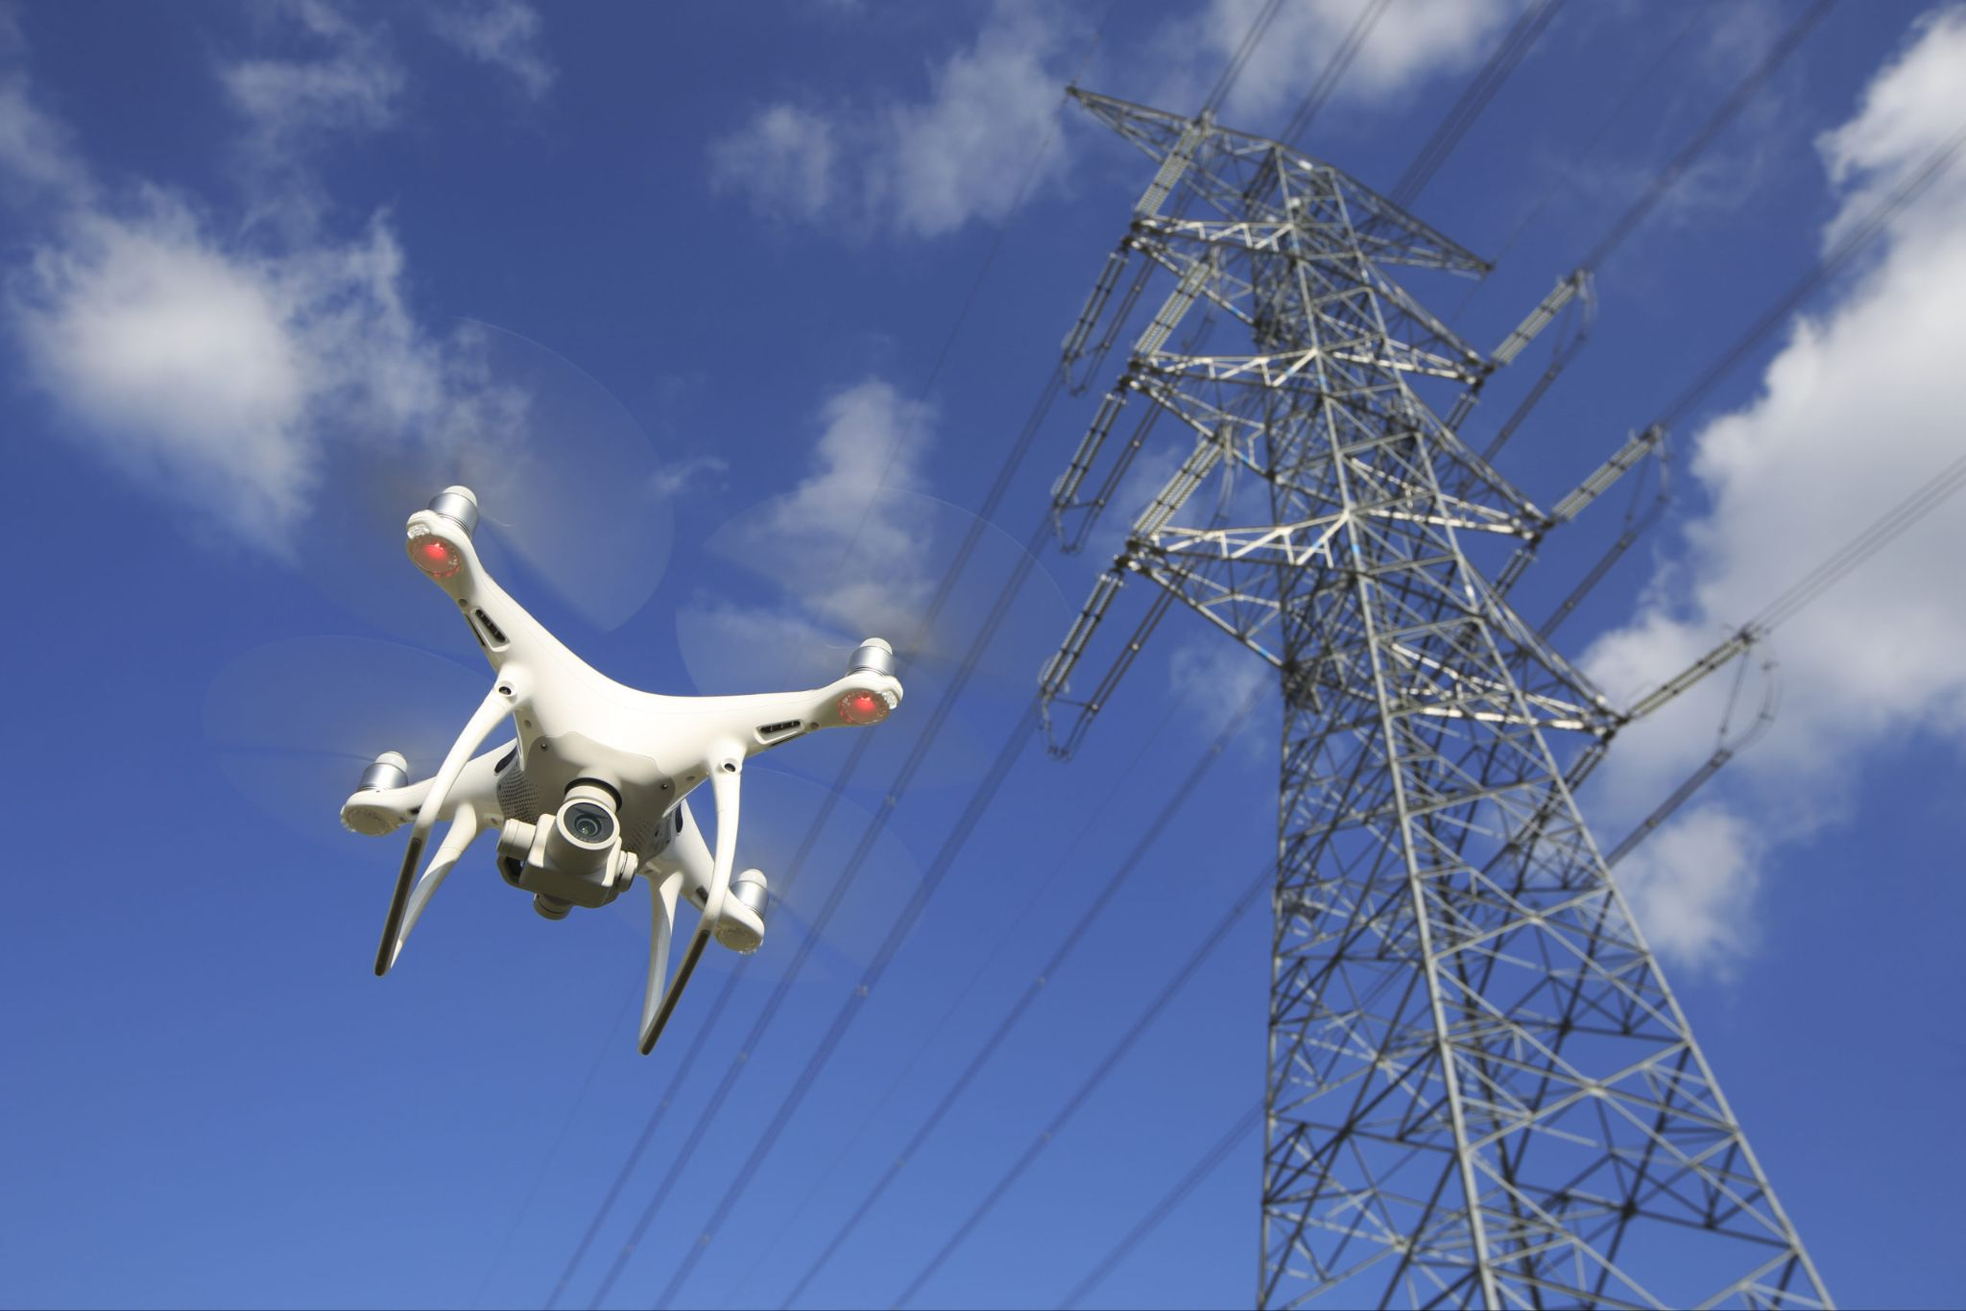
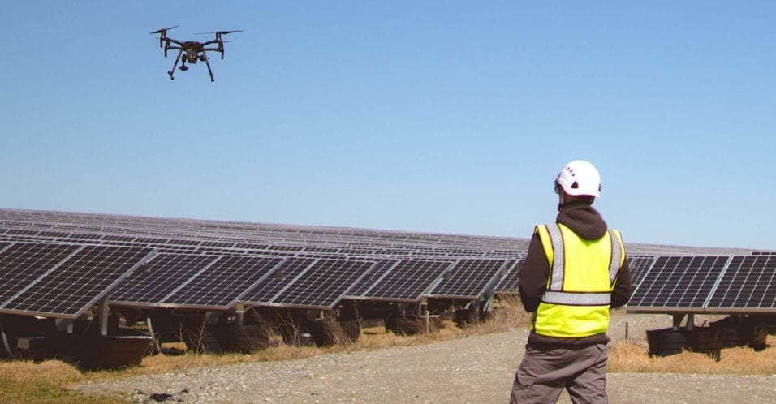
Where are we now?
Credit: scopito.com
Credit: aeromotus.com
Credit: roboticsbusinessreview.com
Credit: qlddrones.com.au
Notes:
Drones are being used in:
Roof inspections
Construction
Tower, power lines, cellular inspections
Solar panel inspections
And other fields

Slide 5
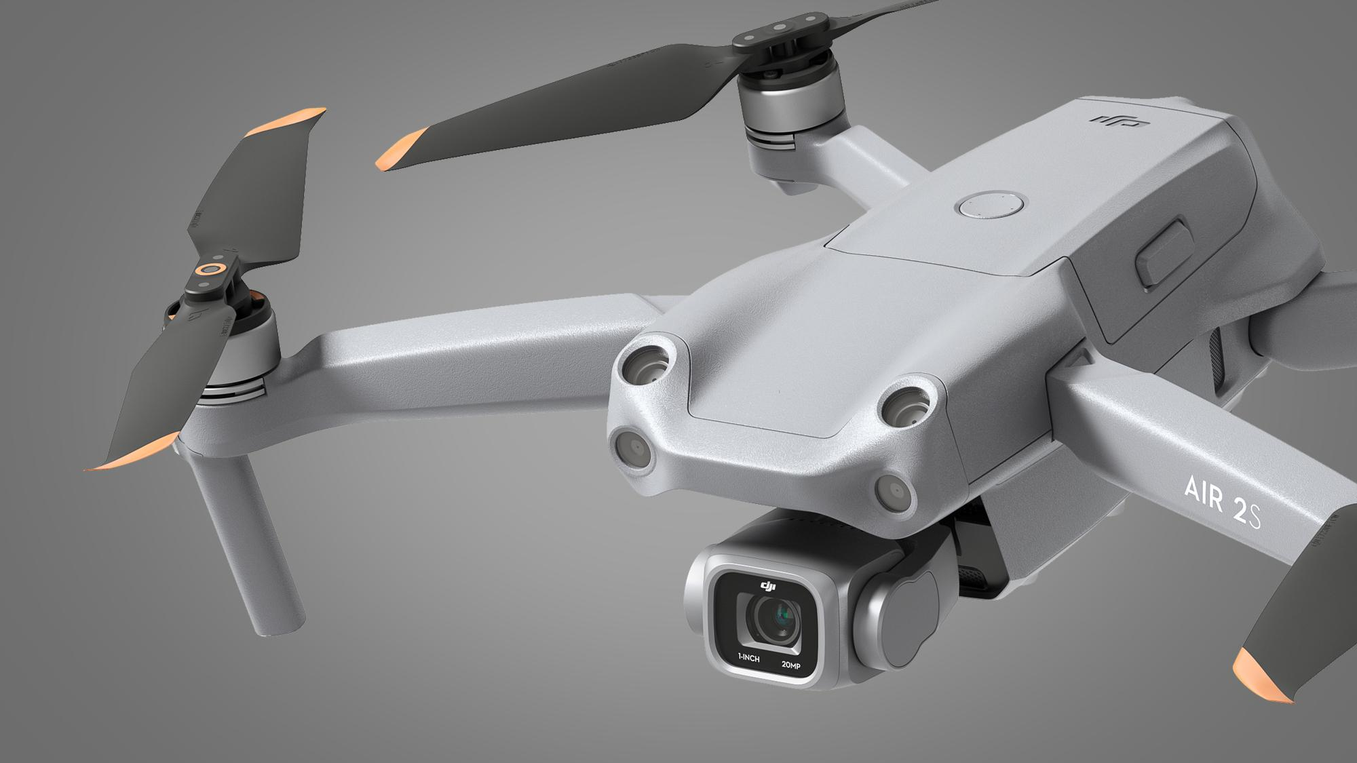
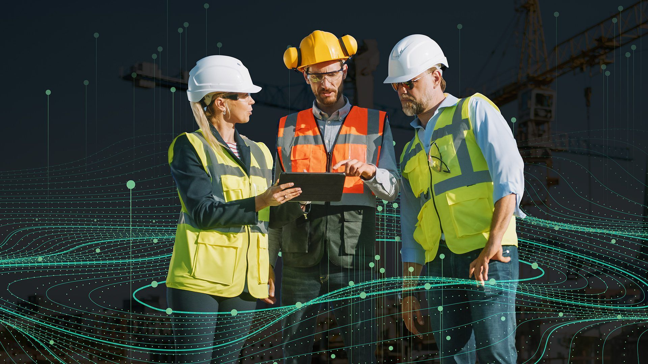
How?
Credit: techradar.com
Credit: autodesk.com
Hardware
Software
Notes:
Larger term project would include integrating the capability onto drones and automating drone collection of projects, but for the time being, our team will focus on the software application, using ML and object identification, as well as a UI to assist with reviewing the results

Slide 6
Users
Architects
Construction Workers
Structural Engineers
Customer (Homeowner, Commercial, Government)
Regulatory Entities (Local, State, Federal)

Slide 7
User Stories: Architect
I want to review an ongoing or final project to track its progress and determine if it meets the original design
I want the ability to capture data of existing buildings to use as inspiration and note issues that were not considered during the drafting and planning phase
I want the ability to generate 3D models of projects
I want a tool that flags concerning anomalies in buildings, such as cracks, erosion, water damage

Slide 8
User Stories: Construction Worker
I want the ability to remotely monitor all aspects construction progress
I need to quickly analyze project details and track/monitor any issues that need to be addressed
I need a capability that can provide insight of hard to reach or hazardous project locations (e.g. roof, tower, etc.)
I need a capability that can detect materials and components

Slide 9
User Stories: Structural Engineers
I need a capability to assist me in inspecting hard to reach locations of a construction site or building to assess integrity
I need to collect lots of data and a tool to quickly analyze the data and highlight areas of high risk
I need a tool to provide probability measurements based on data analytics
I need a capability that can assess material and other details automatically

Slide 10
Owner Stories: Customers / Client
I want a tool that allows me to remotely monitor a building project remotely
I want to be kept informed of the project status and provided pictures and analytics from on-site personnel
I want to inspect building materials and need a tool that can highlight areas of concern
I want to be able to access the data quickly and remotely
I want a user friendly interface

Slide 11
User Stories: Regulatory
I need a capability that can allow me to efficiently monitor projects under my jurisdiction remotely
I want the ability to access hard to reach or dangerous locations of a building or build project to ensure regulations and requirements are being met
I need a tool that can provide me results that highlight possible issues that will need to be addressed in the near future
I need a database system to store and process the data from multiple projects under my area of responsibility

Slide 12
Minimum Valued Product(s)
A capability that can ingest data (e.g. video or images); takes input from user
Multiple file formats?
It must be able to process the data in a timely manner
Seconds to minutes preferred
The capability needs to analyze the data and highlight potential issues, such as: cracks, holes, corrosion, water, etc.
Maybe detect material (brick, mortar, wood, metal, etc.)
The results need to be easily accessible and understandable to the user
The user interface (UI) needs to be user-friendly

Slide 13
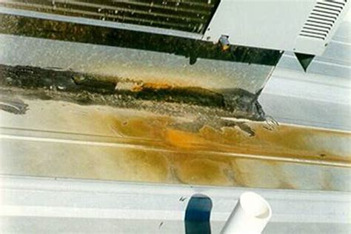
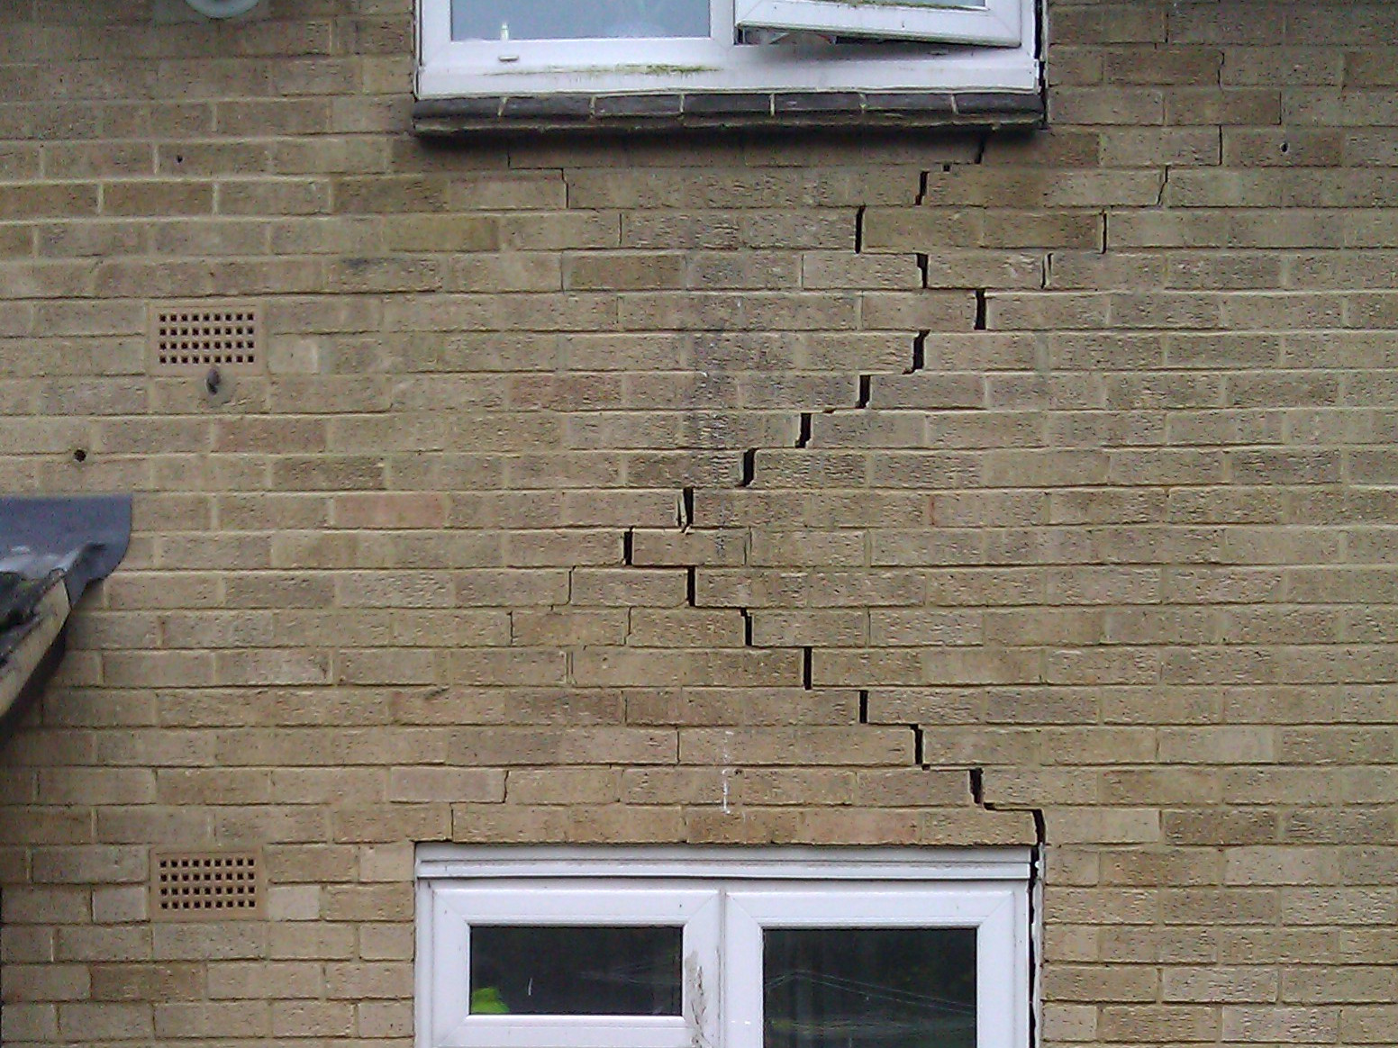
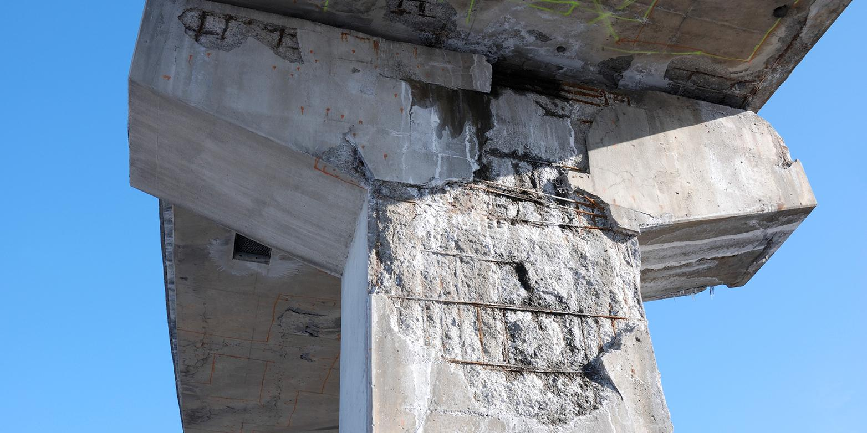
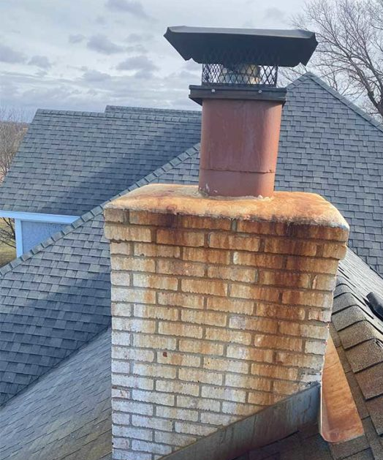
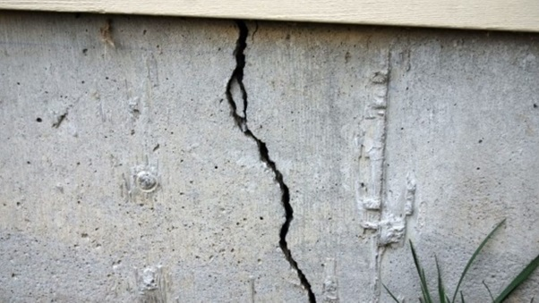
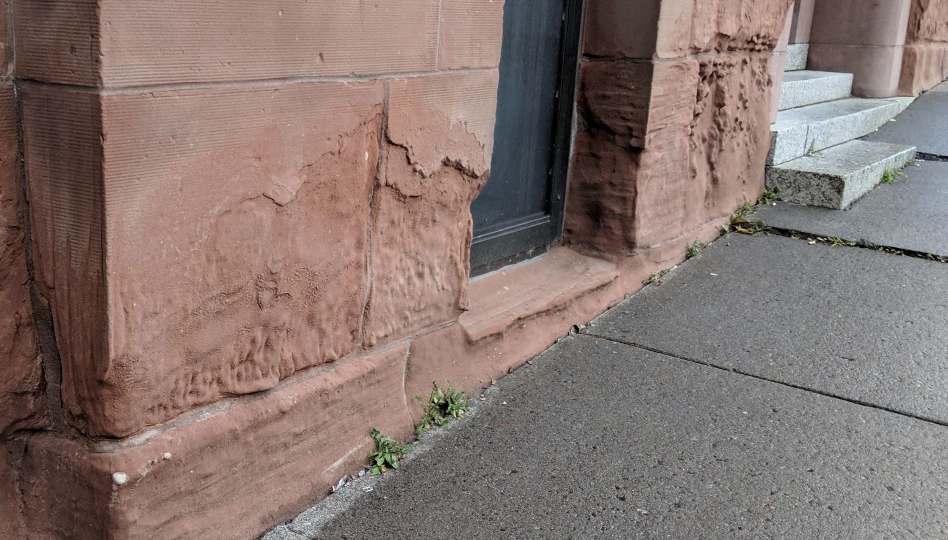
Primary MVP
Credit: blog.mbci.com
Credit: targetstructural.co.uk
Credit: ethz.ch
Credit: constrofacilitator.com
Credit: reddit.com
Credit: fullservicechimney.com

Slide 14
Literature and Research Summary
Current Players and Capabilities:
Talon.io
DJI
Qii.ai
Common themes:
Need for improved detection of subtle issues (improved image processing)
Improved automation capabilities
Consideration of other building health factors that might not be detected using drone acquired data

Slide 15
Technologies and Dev Environment
Software
Google’s CloudVision AI
Microsoft Azure AI Vision
Amazon Rekognition
PyTorch
OpenCV
MATLAB
Dev Environment
Slack for collaboration and communication
GitHub
Google Drive
Drones Integration (pending time and feasibility)

Slide 16
Sprint Goals
Sprint 2: Get familiar with
Image processing tools and experimenting with various APIs
Drone hardware and software
Sprint 3: Work on the capability that can detect cracks, erosion, and other potential issues that would be concerning
Sprint 4: Learn how to design interface of the application
Sprint 5: Package image processing code with interface

Slide 17
Questions?
?

